Slide 1
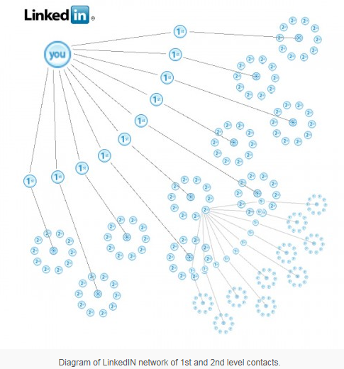
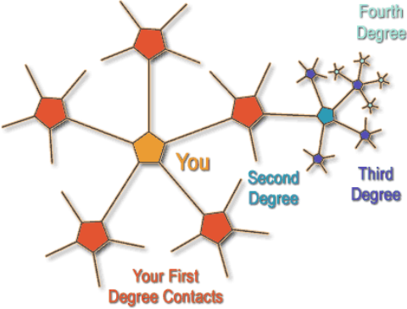
Building Your Linkedin Network to 500 connections

Slide 2
How DO You Start
Contact everyone you know and respect from past positions.
If you have the above emails, send them an email & have them invite you! (In Linkedin free account you get 100 searches per month.)
Out of former company business associates such as sales people, consultants, business partners.
Peers from business related events (Trade shows, Organization meetings).
Search for Linkedin groups to follow that are common to your field.
Search possible target companies to follow that have company Linkedin profiles.
Noconet associates.
College friends.

Slide 3
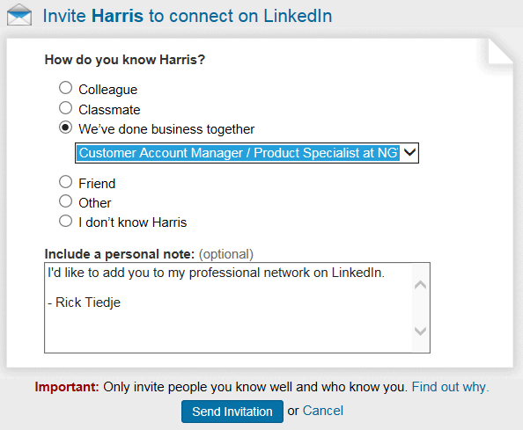
When You Send An Invite, Make it Personal
It is best to put a “personal” touch in the note area.
Please accept my invitation as we share a common interest etc…

Slide 4
After You Send An Invitation You Will Get A Screen Like Below To Invite More Connections

Slide 5
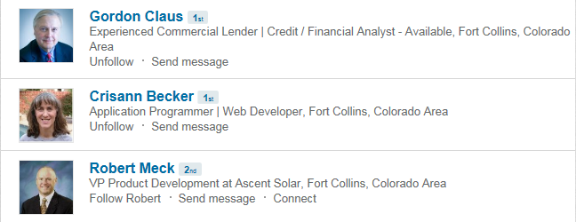
Join A Group So You Can See Others That Are Following The Group
Click on the Join button
The members of the group that you are not connected to are your second degree connections

Slide 6
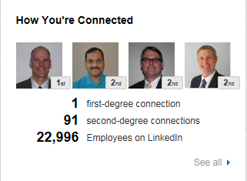
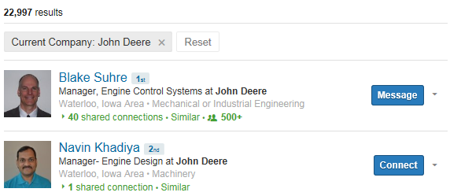
Search Companies To Follow

